Slide 1
Graphs (implementation)
These slides will help you to implement the classes Graph and GraphNode as seen in the Lecture.
They also contain exercises which will be very helpful for the assessed tasks.

Slide 2
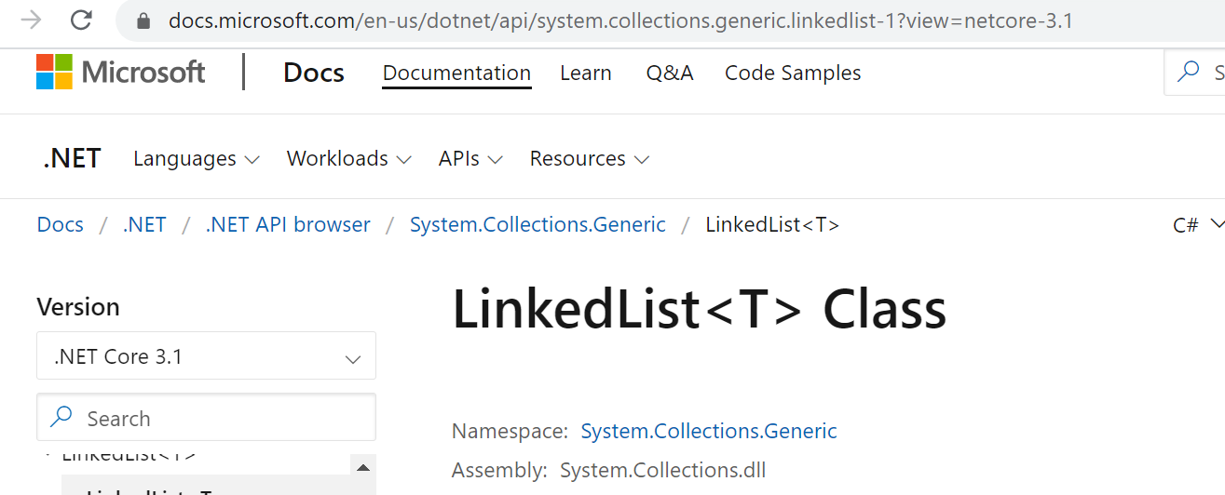
Using LinkedList C#

Slide 3
Directed graph (digraph)
digraphs
G1=<a,b,c,d,e, (a,b),(a,c),(c,d),(c,e)>
G2=<a,b,c,d, (a,a),(a,b),(b,c),(c,a),(c,d)>
a
b
e
a
b
c
d
d
c
Unconnected - no directed path
between e,d
Acyclic
Longest path = 3 nodes
Cyclic

Slide 4
Graph Data Structures
Directed edges (arrows)
Di-graph (directed graph)
Outgoing edges of a node: directed edges where the node is the origin
Incoming edges of a node: directed edges where the node is the destination
a
b
e
d
c

Slide 5
Graph Data Structures
Adjacency List
create a list for each vertex v
insert into list all vertices which are adjacent to vertex v (order not important)
if there are no adjacent vertices {degree v = 0},
the list is empty
a
b
a → b → d → null
b → e → null
c → d →a → null
d → e → null
e → null
e
d
c

Slide 6
Graph Data Structures
c
a
a → c → e → null
b → a → d → null
c → b →null
d → e → null
e → c → null
b
e
d
Adjacency list

Slide 7
Implementation Class GraphNode
GraphNode // it is the single node
Node id (data stored in the node), adjacency list
Graph //it is the entire graph
List of all nodes in graph, methods for add/delete nodes, edges, graph traversal etc.
A
A
B
A
B
A
id
B
adjList
GraphNode
Notes:
Think of Node ID as the label (name) of the node

Slide 8
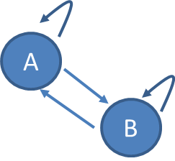
Implementation Class GraphNode
GraphNode // the single node (id of node is generic)
Members
T id
LinkedList<T> adjList
Constructor – GraphNode (T id)
Property (set/get) ID
void AddEdge(GraphNode to)
Add to.ID to adjList
LinkedList<T> GetAdjList()
GraphNode
adjList
id
A
B
A
B
A
B

Slide 9
Open a new project (Console App.) called GraphLab

Slide 10
Add Class GraphNode to your Project
public class GraphNode<T>
{
private T id; // data stored in the node. can think like the (unique) "label" of the node
private LinkedList<T> adjList; // adjacent list of the node
}

Slide 11
Add in class GraphNode
// constructor
public GraphNode(T id)
{
this.id = id;
adjList = new LinkedList<T>();
}
// set and get the data stored in the node
public T ID
{
set { id = value; }
get { return id; }
}

Slide 12
Add in class GraphNode
//add edge from this node to the node "to"; it is an unweighted and *directed* graph.
public void AddEdge(GraphNode<T> to)
{
adjList.AddLast(to.ID);
}

Slide 13
Add in class GraphNode
// return the adjacent list of the node (needed for the visit of the graph)
public LinkedList<T> GetAdjList()
{
return adjList;
}

Slide 14
Implementation Class Graph
Graph // it is the entire graph
List of all nodes in graph, methods for add/delete nodes, edges, graph traversal etc.
Graph
A
A
B
A
B
A
id
B
adjList
list of all nodes in the graph
Notes:
GraphNode represents the node of the Graph. Graph represents the entire Graph
Think of Node ID as the label (name) of the node

Slide 15
Implementation Class Graph
Graph // the entire graph
Members: LinkedList<GraphNode> nodes
Constructor – graph
void AddNode(T id)
void AddEdge(T from, T to)
GraphNode GetNodeByID(T id)
bool IsEmptyGraph()
bool ContainsGraph(graphNode node)
bool IsAdjacent(GraphNode from, GraphNode to)
Graph
A
B
A
B
A
B
nodes

Slide 16
Add Class Graph to your Project
public class Graph<T> where T : IComparable
{
// list of graphnodes in the graph (nodes in the graph)
private LinkedList<GraphNode<T>> nodes;
}

Slide 17
Add in class Graph
// constructor. set the list of nodes in the graph to be the empty list
public Graph()
{
nodes = new LinkedList<GraphNode<T>>();
}
// check if the graph is empty (no node is present)
public bool IsEmptyGraph()
{
//if the number of the elements within nodes is equal to 0, return true;
//otherwise, return false;
return nodes.Count==0;
}

Slide 18
Add in class Graph
// add a new node in the graph. use constructor of graphnode
public void AddNode(T id)
{
nodes.AddLast(new GraphNode<T>(id));
}

Slide 19
Add in class Graph
// only returns true if node is present in the graph
public bool ContainsGraph(GraphNode<T> node)
{
// validation to be completed: add a check that node is not null
foreach (GraphNode<T> n in nodes)
{
if (n.ID.CompareTo(node.ID) == 0)
{
return true;
}
}
return false;
}

Slide 20
Add in class Graph
//returns the node with this id
public GraphNode<T> GetNodeByID(T id)
{
foreach (GraphNode<T> n in nodes)
{
if (id.CompareTo(n.ID)==0) return n;
}
return null;
}

Slide 21
Add in class Graph
//Add a directed edge between the node with id "from" and the node with id “to”
public void AddEdge(T from, T to)
{
GraphNode<T> n1 = GetNodeByID(from);
GraphNode<T> n2 = GetNodeByID(to);
if (n1 != null & n2 != null)
{
n1.AddEdge(n2);
}
else
Console.WriteLine("Node/s not found in the graph. Cannot add the edge");
}

Slide 22
Test the Graph in Main()
// define a graph with ID of nodes as 'char'
Graph<char> myGraph = new Graph<char>();
// add nodes in the graph
myGraph.AddNode('A');
myGraph.AddNode('B');
myGraph.AddNode('C');
myGraph.AddNode('D');
myGraph.AddNode('E');
// add connections between the nodes. these are direct edges
myGraph.AddEdge('A', 'B');
myGraph.AddEdge('A', 'C');
myGraph.AddEdge('B', 'C');
myGraph.AddEdge('D', 'A');
myGraph.AddEdge('D', 'E');
myGraph.AddEdge('A', 'E');

Slide 23
Test the Graph in Main()
Console.WriteLine("Is myGraph empty? Answer: {0}", myGraph.IsEmptyGraph());
// is there an edge from 'A' to 'B' ?
Console.WriteLine("Is there an edge from {0} to {1}? {2}",
myGraph.GetNodeByID('A').ID, myGraph.GetNodeByID('B').ID,
myGraph.GetNodeByID('A').GetAdjList().Contains('B'));
// is there an edge from 'B' to 'A' ?
Console.WriteLine("Is there an edge from {0} to {1}? {2}",
myGraph.GetNodeByID('B').ID, myGraph.GetNodeByID('A').ID,
myGraph.GetNodeByID('B').GetAdjList().Contains('A'));
Console.ReadKey();

Slide 24
Add in class Graph
Exercise
// return true if “to” is adjacent to “from”
public bool IsAdjacent(GraphNode<T> from, GraphNode<T> to)
{
foreach (GraphNode<T> n in nodes)
{
// to be completed
// hint: see pseudocode on lecture slides
}
return false;
}

Slide 25
Test IsAdjacent in Main()
Console.WriteLine("Is node {0} adjacent to node {1} ? Answer: {2}",
myGraph.GetNodeByID('B').ID,
myGraph.GetNodeByID('C').ID,
myGraph.IsAdjacent(myGraph.GetNodeByID('C'), myGraph.GetNodeByID('B')));
Console.WriteLine("Is node {0} adjacent to node {1} ? Answer: {2}",
myGraph.GetNodeByID('E').ID,
myGraph.GetNodeByID('D').ID,
myGraph.IsAdjacent(myGraph.GetNodeByID('D'), myGraph.GetNodeByID('E')));
Console.ReadKey();

Slide 26
Add in class Graph
Exercise
// returns the total number of nodes present in the graph
public int NumNodesGraph()
{
// to be completed
// hint: how can you get the list of all nodes in the graph ?
// once you have that list, you can count (and return) how many elements are in the list
}

Slide 27
Add in class Graph
Exercise
// returns the total number of edges present in the graph
public int NumEdgesGraph()
{
// to be completed
// easier way: add an int variable (i.e. counteredges) in class Graph which is increased every time an edge is added
// harder way: to get the total number of edges in the graph you need to count how many outgoing edges each node has and then return the sum obtained considering all nodes in the graph. How can you get the number of outgoing edges for each node ? (i.e., use the adjacency list of the node)
}

Slide 28
Test NumNodesGraph(), NumEdgesGraph() in Main()
For example:
Console.WriteLine(myGraph.NumNodesGraph());

Slide 29
Exercise
In Main()
Display every node of myGraph together the corresponding adjacent nodes
For example
node: A
adjacent nodes: B, C, E
……….(repeat for all nodes of myGraph)

